Slide 1
THE AGE OF DISCOVERY

Slide 2
INTRODUCTION:
The era known as the Age of Exploration, sometimes called the Age of Discovery, officially began in the early 15th century and lasted through the 17th century.
The period is characterized as a time when Europeans began exploring the world by sea in search of new trading routes, wealth, and knowledge.
They were in search of trading goods such as gold, ivory and spices. In the process, Europeans met people and mapped lands previously unknown to them.
It was new routes rather than new lands that filled the minds of kings and commoners, scholars and seamen.
Knowledge that generated from renaissance and scientific revolution was helping European nations in exploring new opportunities in the hitherto unexplored world.
Christopher Columbus, Vasco da Gama, Bartholomeu Dias and Ferdinand Magellan were some famous scholars of this period who transformed the Global Geography, politics, economy and much more.

Slide 3
CAUSES:
European countries had traditionally traded with eastern countries mainly through land. Silk road was a famous route of the medieval period. But it was mostly over land and took merchants a great deal of time to ship goods. European countries were interested in speeding up trade by finding a quicker sea route.
When the Ottoman Empire took control of Constantinople in 1453, it blocked European access to the area, severely limiting trade. In addition, it also blocked access to North Africa and the Red Sea, two very important trade routes to the Far East.
A big reason for the beginning of the Age of Exploration was the rise of absolute monarchies in Europe. The powerful monarchs of Europe had centralized the authority and wealth of each country and used their vast wealth to fund the expeditions of many explorers. For example, Christopher Columbus was funded by the King and queen of Spain.
Europeans had made some dramatic improvements in their navigational skill and technology that allowed early explorers to travel further and more accurately at sea. For example, ship building and navigation had drastically improved in the years immediately before the Age of Exploration began.
Europeans of the time were interested in foreign cultures and goods. In general, the Renaissance in Europe caused an expansion of new ideas and new understandings of the world.

Slide 4
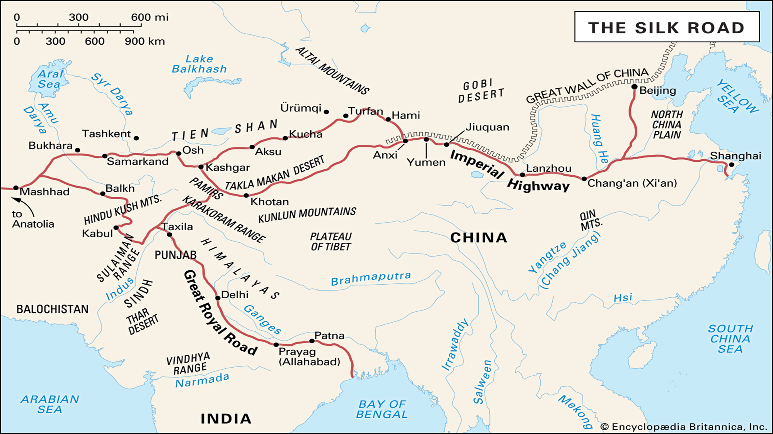

Slide 5
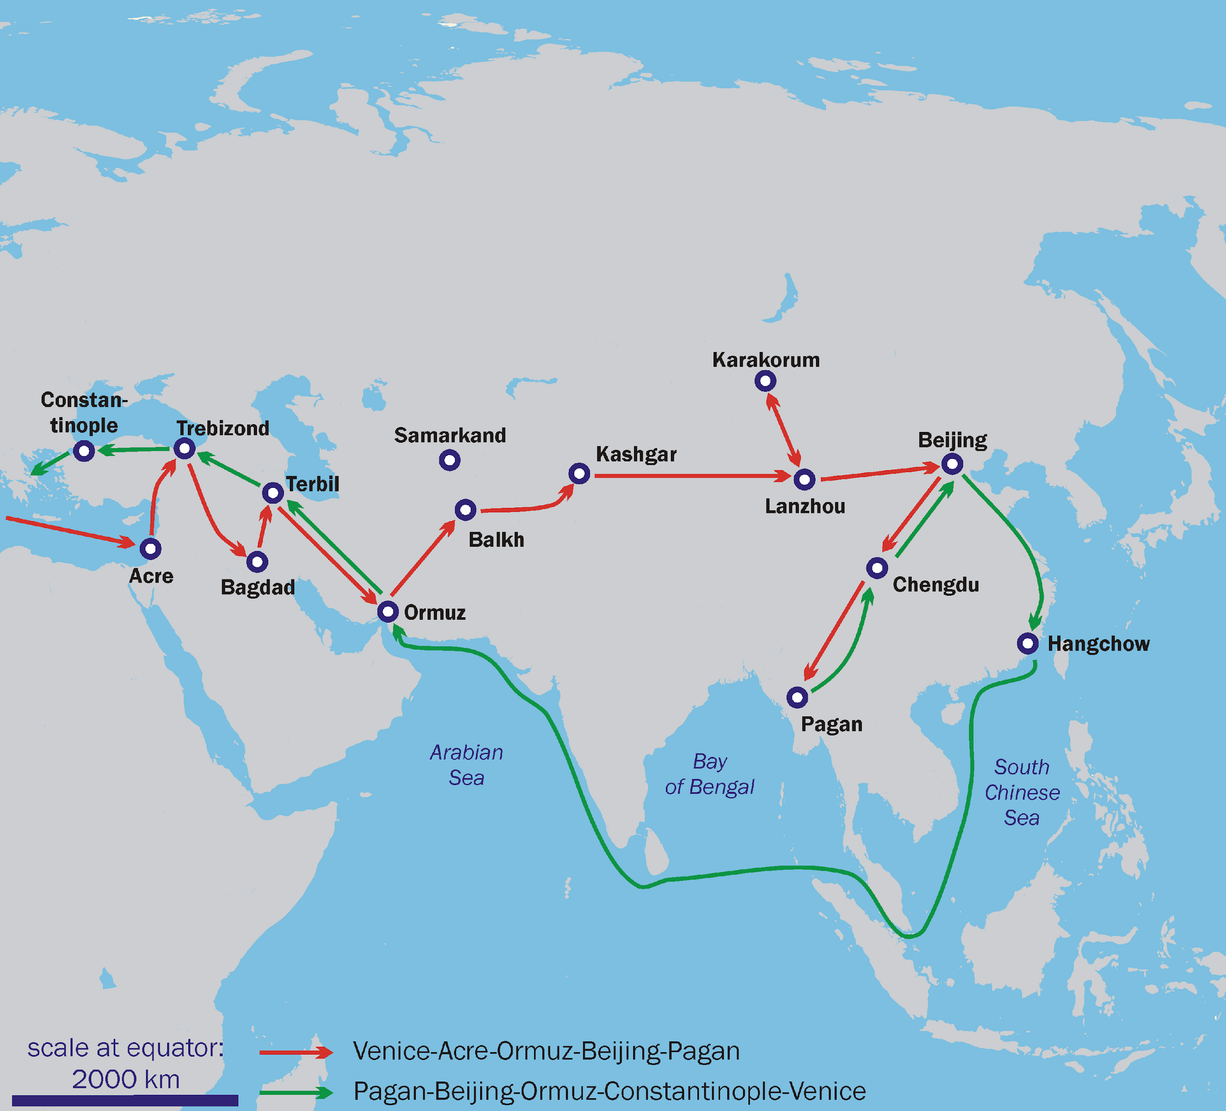
Travel route of Marco Polo.
This journey of Marco polo was taken long before age of discovery (from 1271 to 1295). his travel accounts generated the curiosity about the rich wealth and culture of the East and inspired many Europeans to travel across the world.

Slide 6
PROGRESS OF EXPLORATION:
The Age of Exploration is considered to have occurred mostly with four European nations, which included: Portugal, Spain, France and England.
They were all countries that bordered on the Atlantic Ocean and had easy access to the sea with many sea ports and experienced sailors. This allowed these four nations to have the ability to begin exploring while other European nations did not.
Portugal is considered to have started the Age of Exploration ahead of the other three nations with the expeditions that were carried out under Prince Henry ‘the Navigator’. Although he never directly carried out any trips of his own, Henry was vital in Portugal’s earliest trips and for revolutionizing the way that these trips were recorded.
He set up a School of navigation in 1419 and under his direction sailors perfected sailing techniques, navigational tools, designs for sails and different mapping techniques. For example, he is credited with being the first to require captains of ships to keep a record or log of their journeys. This was important because it allowed different explorers to combine their findings to build up a common knowledge base of discoveries.

Slide 7
Early Portuguese explorers travelled south along the western coast of Africa in search of a new route to India and China in the early 1400s. They gradually pushed farther south along the African coast reaching the Cape of Good Hope in 1488. In 1498, Vasco da Gama followed this route and went further ahead to India.
Portugal’s neighbor, Spain wanted to begin its own explorations. Instead of heading south, like Portuguese sailors, Spanish explorers headed west across the Atlantic Ocean. These early explorers were seeking a quicker trade route to the Far East, including China and India.
The most famous example of early Spanish explorers is Christopher Columbus. Columbus, while being of Italian nationality, sailed for Spain after being funded by the king and queen of Spain. He is credited with being the first European to explore the New World in 1492, which later named America. Instead of reaching India, Columbus found the island of San Salvador in what is known today as the Bahamas, part of Caribbean islands.
Seeing the increased wealth of Portugal and Spain, Britain and France also started taking interest in exploring new lands in late 1500s. This was the beginning of contention among the European nations for the control of rich resources of Newly explored lands of America, Asia and Africa.

Slide 8
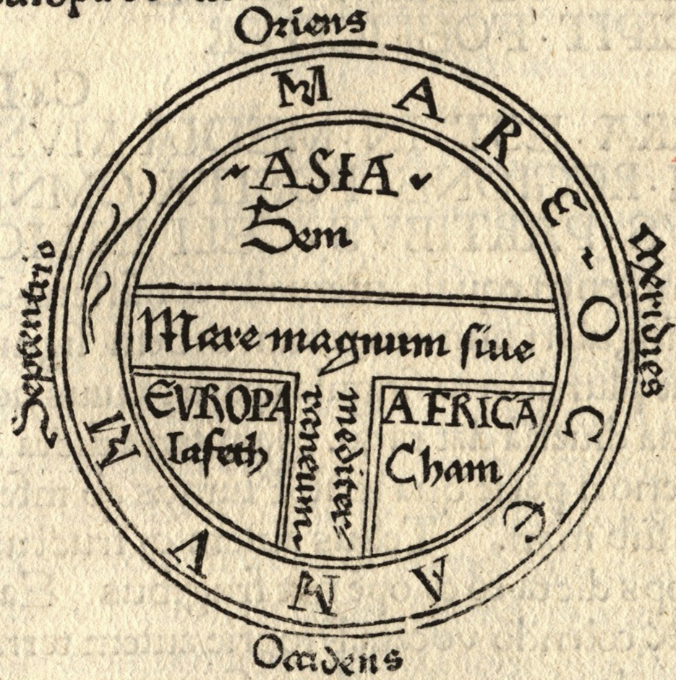
Cartography before the Age of Discovery
https://www.geographyrealm.com/types-medieval-european-maps/

Slide 9
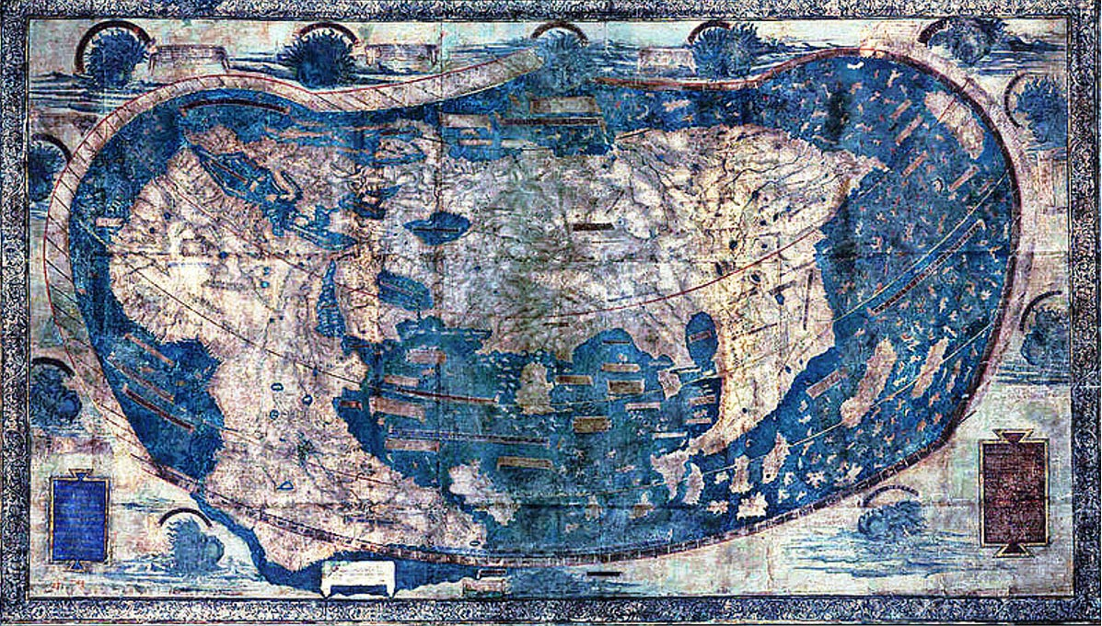
This map of world by Henricus Martellus was made in 1491 with the help of many small maps and voyage accounts by numerous seamen. The delineation of the west coast of southern Africa from the Guinea Gulf to the Cape suggests a knowledge of the charts of the expedition of Bartolomeu Dias. Christopher Columbus, while planning for his first voyage In 1492, took help of this map. We clearly see no mention of America here. Planning of Columbus was to sail westward, so that he could get a short route for Asia, especially India.

Slide 10
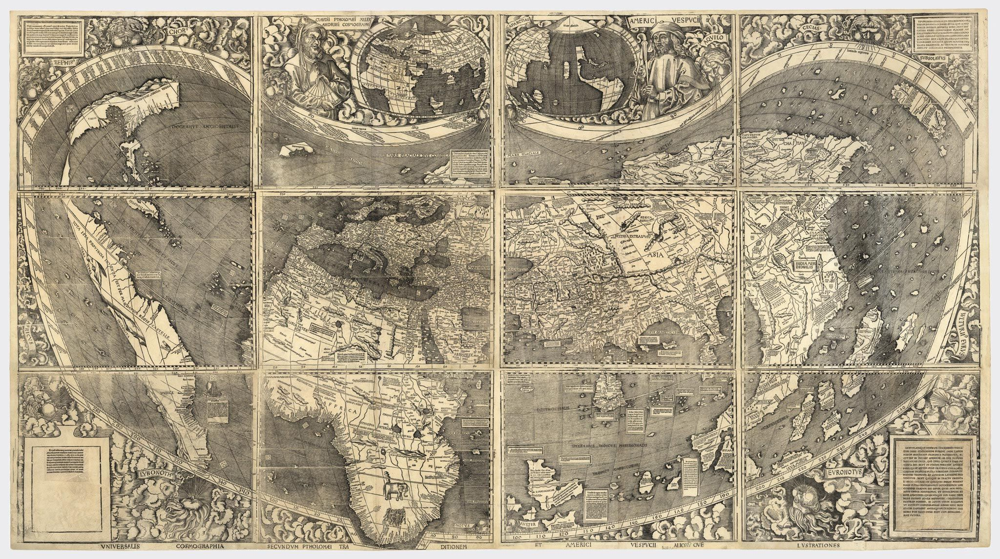
This map is made by Waldseemüller in 1507.
Now , Africa is more accurate in representation and the European cartography got a new continent, America.

Slide 11
Previous two maps shows the interdependency of the explorers and cartographers in the age of geographical discoveries. The explorers were helping cartographers by providing the information they gathered in their travels and the cartographers, in return, were assisting the explorers in their voyages through the addition of information on maps hence, increasing their accuracy and reliability.

Slide 12
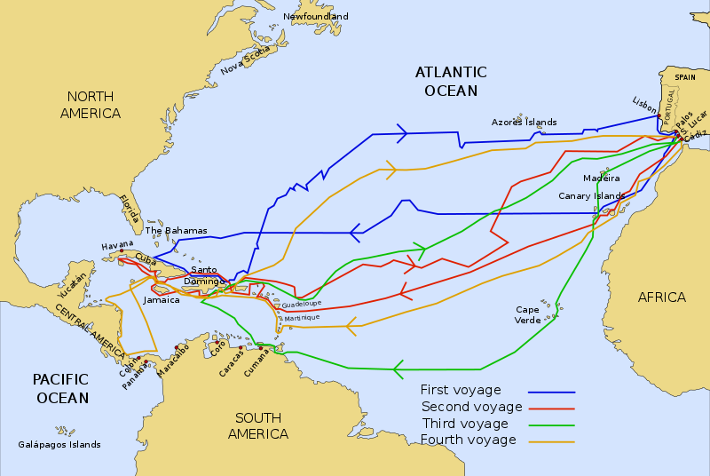
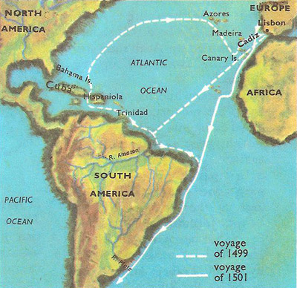
First (Left) is the route map of voyages by Christopher Columbus. Second (Right) is the route map of voyages by Amerigo Vespucci.

Slide 13
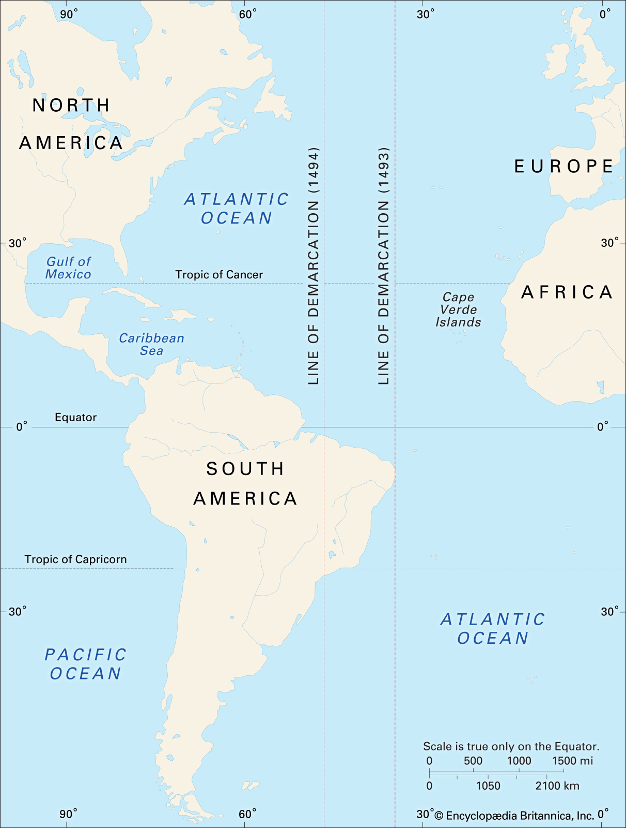
Treaty of Tordesillas
Map showing the line of demarcation between Spanish and Portuguese territory, as first defined by Pope Alexander VI (1493) and later revised by the Treaty of Tordesillas (1494). Spain won control of lands discovered west of the line, while Portugal gained rights to new lands to the east.
Source: Encyclopædia Britannica, Inc.

Slide 14
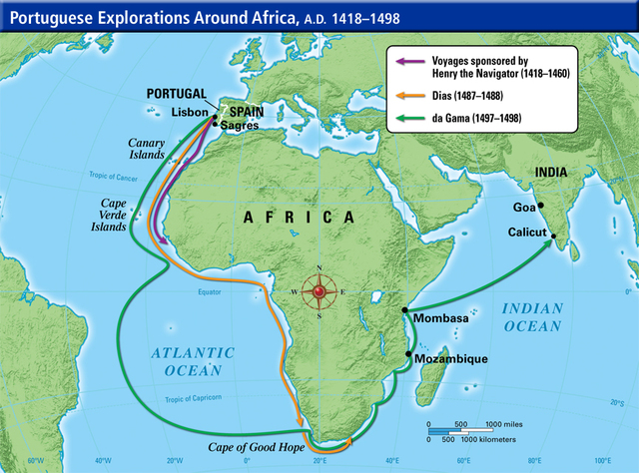
Henry the navigator of Portugal promoted the voyages around the western coast of Africa (purple). Bartolomeu Dias went further ahead and reached till southern coast of Africa, known as Cape of Good Hope (orange). His voyage discovered a way to Asia beyond African southern coast and later, a sailor named Vasco da Gama took advantage of the previous findings reached to the Western coast of India(green).

Slide 15
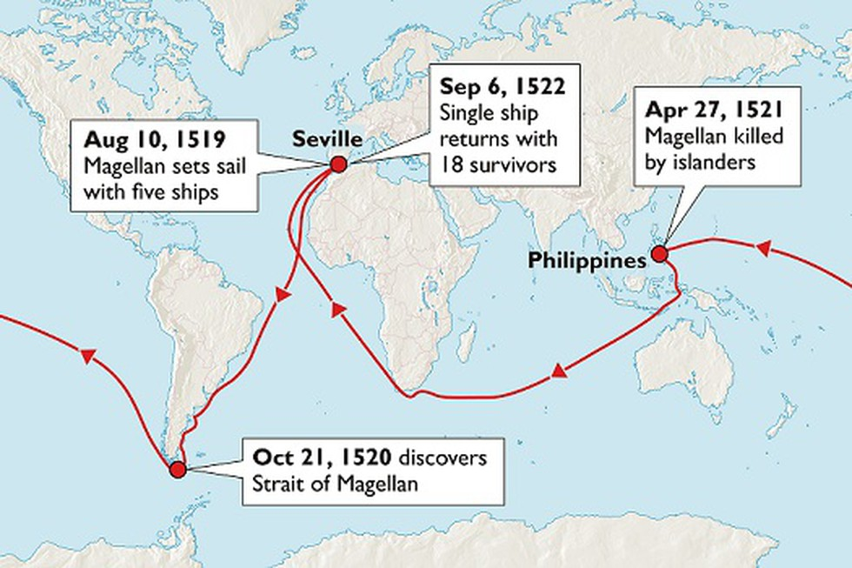
Ferdinand Magellan’s Circumnavigation of the globe
https://youtu.be/pFdiX8mj0Es

Slide 16
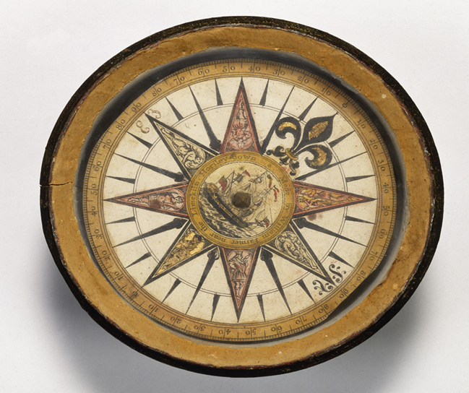
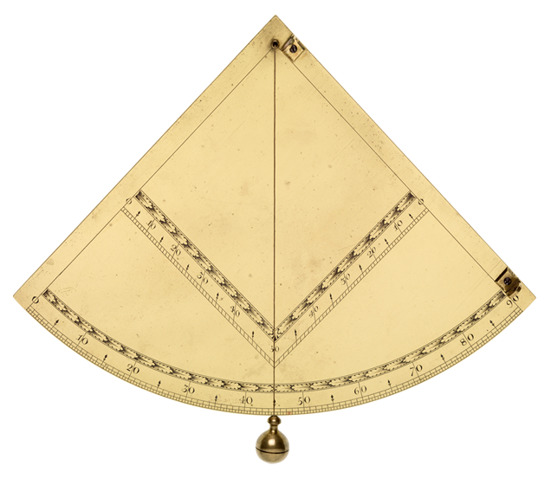
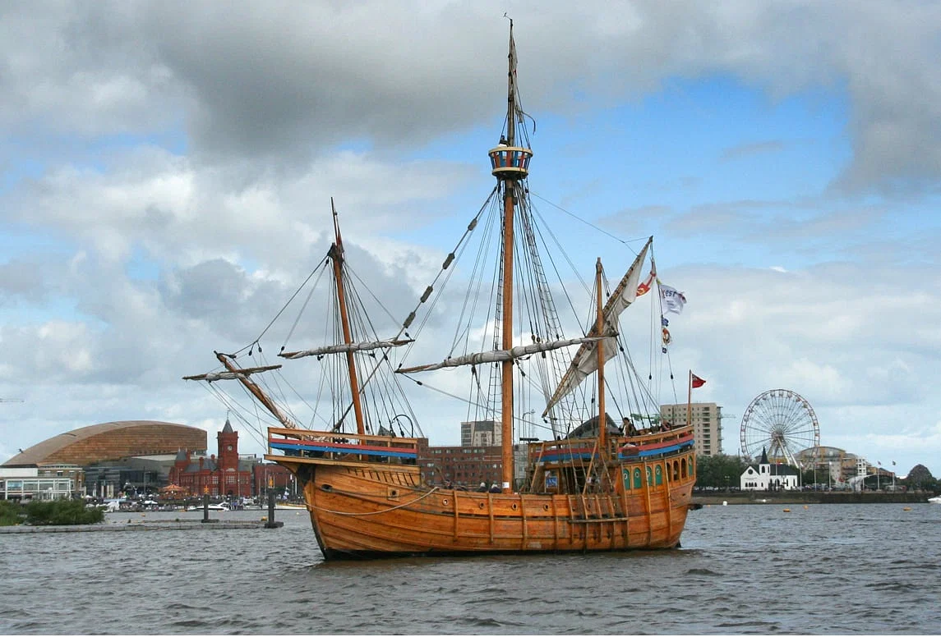
NAVIGATION TOOLS (Links and Videos)
https://exploration.marinersmuseum.org/object/compass/
https://www.mpofcinci.com/blog/navigation-during-the-age-of-discovery//
https://www.iro.umontreal.ca/~vaucher/History/Ships/Ships_Discovery/index.html
https://youtu.be/uExoQJmAa_w
https://youtu.be/41QcsGuK9o0
https://youtu.be/C4hBN6uElyU
https://youtu.be/-gK87XVCaN8
https://youtu.be/tZ_J9xbvcWI?si=ym7e8Ku0GotwJPnh
https://youtu.be/Eup2J0oAq9Y

Slide 17
Helpful Link:
https://www.thoughtco.com/age-of-exploration-1435006

